Slide 1

Machine learning to predict clinical outcomes from RNS background ECoG
Byron Sun, Xiaojing Wu PhD, Anli A. Liu MD MA
NYU Comprehensive Epilepsy Center
ANA Meeting, October 21, 2018
Notes:
The topic I am going to talk about today is…

Slide 2
Limitations of current RNS practice
Long intervals between seizures and between programming visits (2-3 months)
Very limited understanding of how stimulation parameters should be adjusted
Can we build a reliable classifier for an individual patient which predicts clinical outcome, based on retrospective review of that patient’s background EEG?
Notes:
Let’s first talk about some backgrounds and what’s the problem we are trying to solve here with RNS device?
RNS device is a brain-responsive neurostimulation system designed to prevent epileptic seizures at their source. The physicians who routinely examined the output from patients’ RNS device will adjust the parameter of the device according to the physician’s experience. The problem of this practice is that physicians usually need to wait a long period of time (~2-3 months) to get an idea of whether the adjustments they made to the device has improved or worsened the patient’s condition. We can see that the RNS parameter optimization is a long and slow process.
Why does physicians need to wait so long.
Although seizures are the ultimate indication of clinical outcome, a long time duration is required to reliably estimate seizure occurrence frequency during that given period of time
Also, physicians only hear about how the patient has been doing when meeting with them in person every ~3 months, it would be nice to have tools that generate more frequent quantifications of patients’ epileptic activity directly based on their EEG data

Slide 3
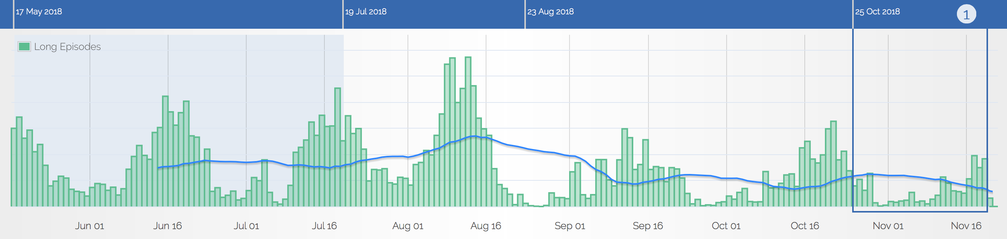
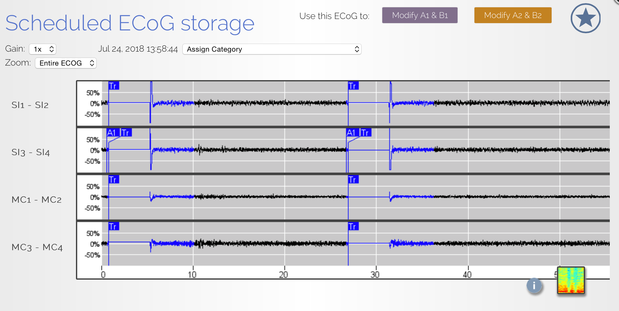
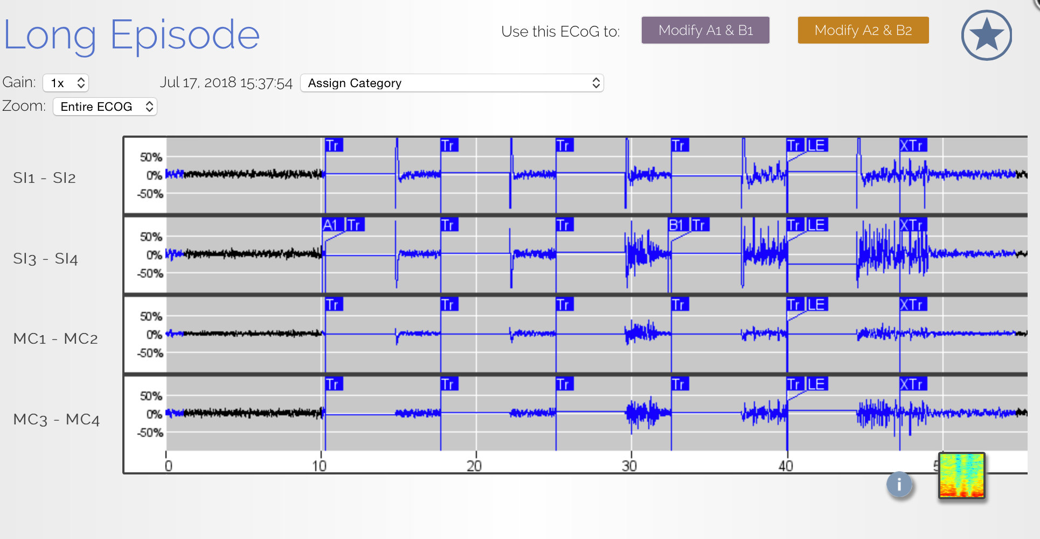
Can we use background ECoG to predict clinical outcome?
“Bad”
“Good”
Notes:
Scheduled ECoGs are directly accessible, usually multiple samples are available each day
Scheduled, i.e. background EEG pattern changes may indicate fundamental changes in the brain network
Therefore, “scheduled” ECoG segments is the ideal data we could use to build a classifier for individual patient.

Slide 4

Methods: Classify EEG into good/bad epochs
Clinical
Visit
↓
Time
No changes in RNS detection parameters
OR antiepileptic medications
1 month epochs
↙ ↓ ↘
GOOD
BAD
GOOD
BAD
BAD
GOOD
GOOD
GOOD
Find long periods of time:
- Long episodes detected by same parameters
- Any EEG pattern change cannot be caused by AED changes
GOOD: relatively low average daily long-episode count
BAD: relatively high average daily long-episode count
Notes:
Let me illustrate our methods using images. The black house represents clinical visits. And we can see there are 5 clinical visits here. In, each clinical visits, physicians may change RNS detection parameters
OR antiepileptic medications. Of course, the RNS device parameter may also be changed. Among all the time we have seen in the image, we will be using the time where there is No changes in RNS detection parameters
OR antiepileptic medications. In other words, we will find long periods of time:
- when Long episodes are detected by same parameters
- and Any EEG pattern change cannot be caused by AED changes
Furthermore, the time we choose can be divided into several 1 month epochs. Each epoch has a label, good or bad. We will be using long episode count as a biomarker for clinical condition in epilepsy treatment. Good means patient’s clinical condition is relatively good, that is there are relatively low average daily long-episode count for that patient. Vice versa

Slide 5
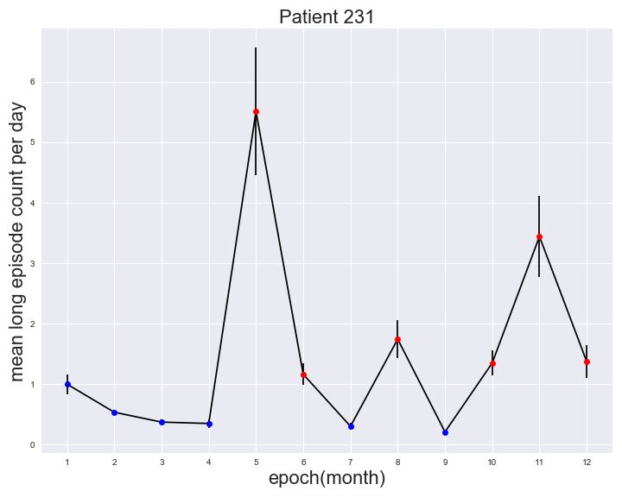
Methods: Classify EEG into good/bad epochs
Notes:
This is an example of the actual data,
1. Maker bigger
12 month clean period
thresholded by median
across the moth
half of the total epochs with higher LE count are bad, the other lower half are good

Slide 6
Methods
Feature calculation
EEG
segment
…
Channel 1
Delta
Channel 2
Delta
Channel 3
Delta
Channel 4
Delta
Channel 1
Theta
Channel 2
Theta
Channel 3
Theta
Channel 4
Theta
(band power)
Classic frequency bands:
Delta = 0.5 - 4 Hz
Theta = 4 - 8 Hz
Alpha = 8 - 12 Hz
Beta = 12 - 25 Hz
Low gamma = 25 - 50 Hz
High gamma = 50 - 124.9 Hz
Entire band = 0.01 - 124.9 Hz
4 channels X 7 frequency bands
= 28 features per EEG segment
Notes:
Remember we try to predict clinical condition, that is the labels mentioned in the last slide based the backgrounds EEG segments recorded. However, we cannot directly use EEG segment in the traditional machine learning model because of the high dimension and high variance nature of the EEG segments. Instead, we use features extracted from EEG segments to build the machine learning model and predict the label based on the features. So each EEG segment can produce ……

Slide 7
Methods: Extract EEG features from each ECOG channel
BAD
Features
EEG
segment
Features
Features
Features
Machine
Learning
Features
EEG
segment
Features
Features
Features
GOOD
Classic frequency bands:
Delta = 0.5 - 4 Hz
Theta = 4 - 8 Hz
Alpha = 8 - 12 Hz
Beta = 12 - 25 Hz
Low gamma = 25 - 50 Hz
High gamma = 50 - 124.9 Hz
Entire band = 0.01 - 124.9 Hz
4 channels X 7 frequency bands
= 28 features per EEG segment
Notes:
How to account for IEDs, sleep, and interictal/preictal as features?

Slide 8
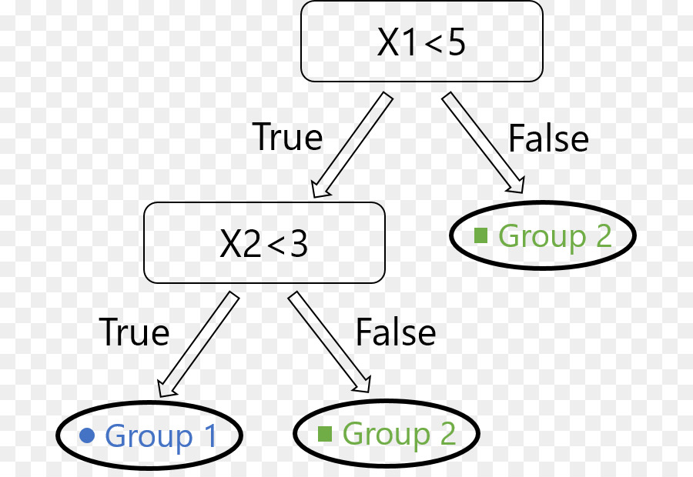
Methods
Machine learning methods
Decision tree

Slide 9
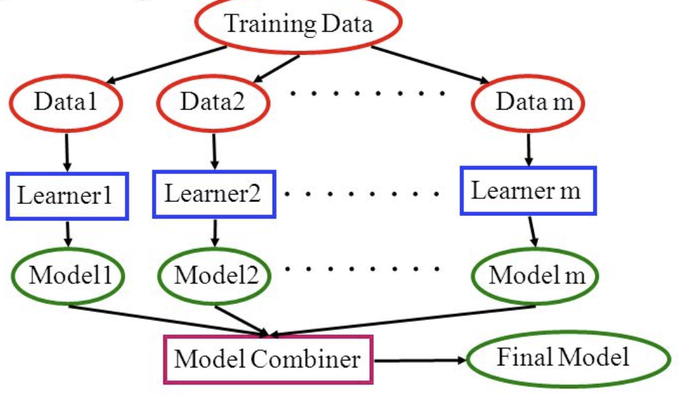
Methods
Machine learning methods
Ensemble Model: Random Forest, Gradient Boosting
Notes:
To begin with, ensembling technique means that prediction is done by an ensemble of simpler estimators
The aim of gradient boosting is to create (or "train") an ensemble of trees, given that we know how to train a single decision tree. This technique is called boosting because we expect an ensemble to work much better than a single estimator.
The intuition is they're all right more often than they're wrong, and different learners tend to be wrong on different examples so when they all vote you often get the right answer.
You can explain why it works using the bias and variance decomposition. In the case of an ensemble of randomized models (e.g., bagging, random forests, etc), randomizing has the effect of increasing the bias of the ensemble slightly, but then often makes it possible the reduce its variance to a larger extent, hence the better overall performance.

Slide 10
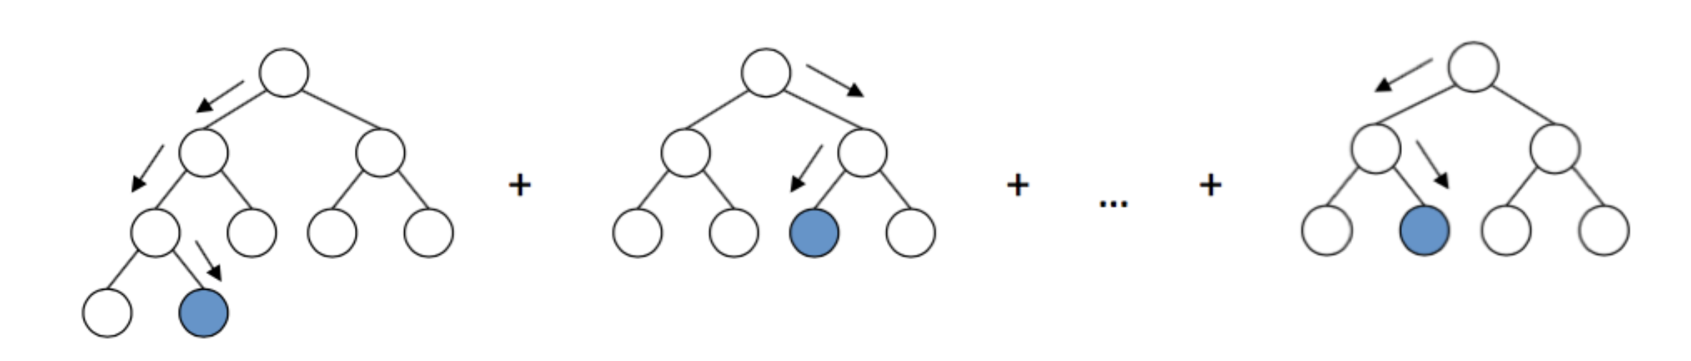
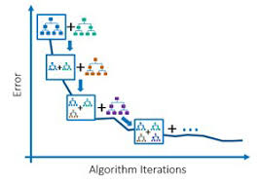
Methods
Machine learning methods
Gradient Boosting
Notes:
Here comes the most interesting part. Gradient boosting builds an ensemble of trees one-by-one, then the predictions of the individual trees are summed:
The next decision tree tries to cover the discrepancy between the target function f(\mathbf{x})f(x) and the current ensemble prediction by reconstructing the residual.

Slide 11
Patient Selection Criteria
Methods
Good RNS upload compliance
Have scheduled ECoGs multiple times per day
Have a relatively clean EEG background
Good clinical correlation between long episodes and clinical seizures
Infrequent medication changes
Past the 6 month window of implant effect, and past the detection adjustment stage.
Notes:
Good RNS upload compliance
Have scheduled ECoGs multiple times per day
Have a relatively clean EEG background
Good clinical correlation between long episodes and clinical seizures
Infrequent medication changes
Past the 6 month window of implant effect, and past the detection adjustment stage.

Slide 12
Methods: Subject selection
Patient ID | Gender | Age | Clean periods (Days) | Leads location
NY231 | F | 33 | 379 | L hippocampal depth R hippocampal depth
NY229 | M | 26 | 318 | Insular depth L mid-central strip
NY222 | M | 25 | 255, 215 | L insular depth L superior temporal strip
Notes:
we've identified one long clean period for ...

Slide 13
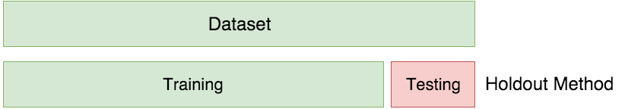
Methods: Training and Testing
80%
20%
Notes:
20% test
1. Remove everything cross validation; move this part to end as supplemental slide

Slide 14
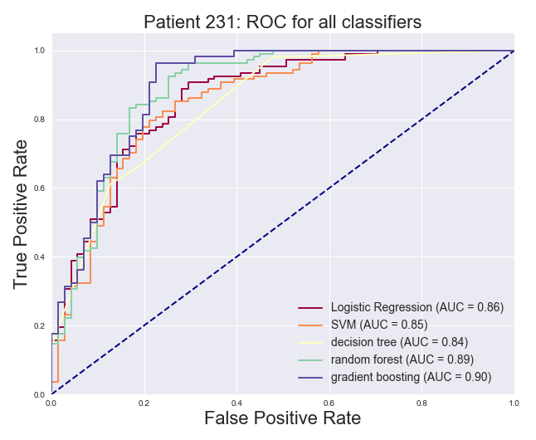
Results: NY231 model with excellent performance
Best classifier for 231 is gradient boosting with AUC = 0.90, accuracy = 87.15%

Slide 15
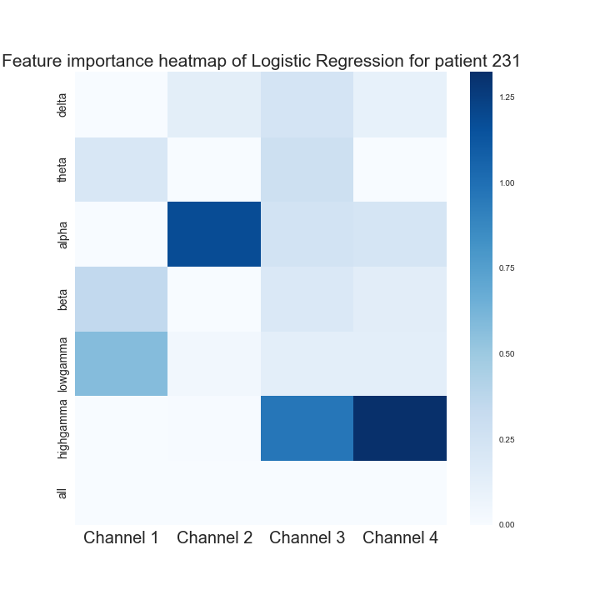
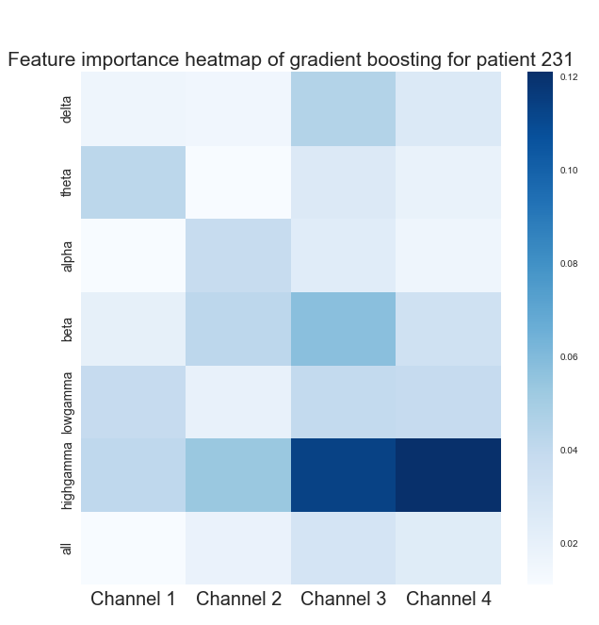
NY 231 Important Features
Logistic Regression
Gradient boosting
Important features:
high gamma Channel 4
alpha Channel 2
high gamma Channel 4
Important features:
high gamma Channel 4
high gamma Channel 3
beta Channel 3
Notes:
Xlable:channel 1, channel 2, …
Put gradient boosting in this same slide

Slide 16
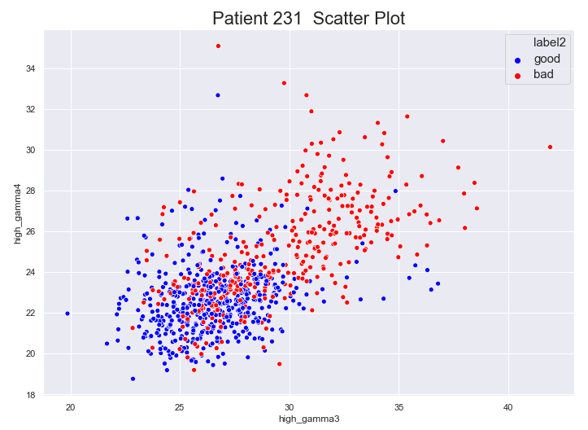
NY 231: Decreased high gamma in background ECoG predicts good outcome
Notes:
Xlable:channel 1, channel 2, …
Put gradient boosting in this same slide

Slide 17
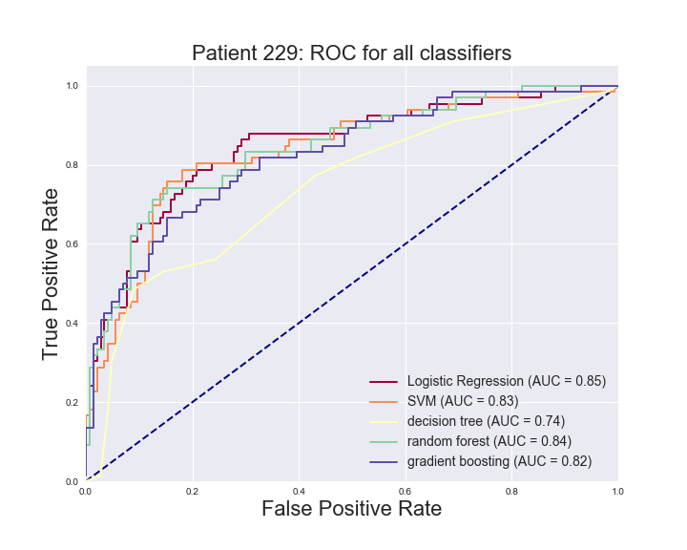
Results: NY229 model with good performance
Best classifier for 229 is Logistic Regression with AUC = 0.85 , accuracy = 81.43%

Slide 18
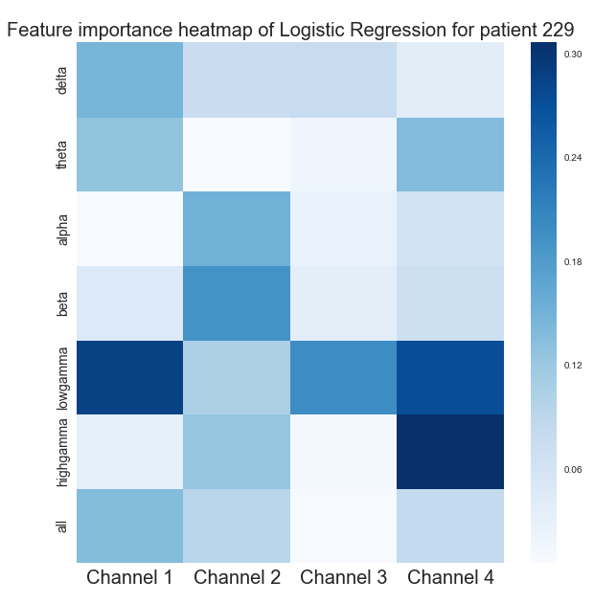
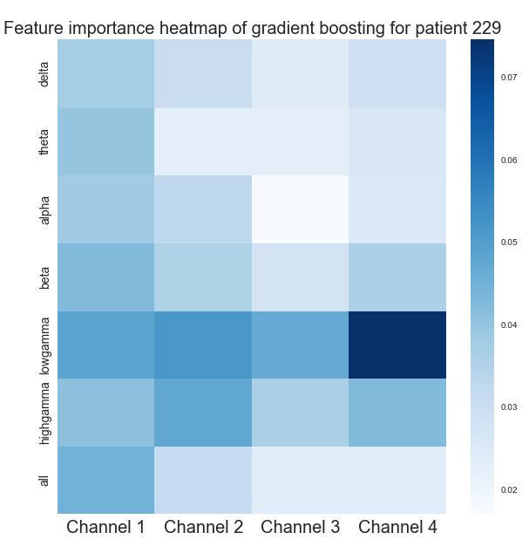
NY229 Important Features
Logistic Regression
Gradient boosting
Important features:
high gamma Channel 4
low gamma Channel 1
low gamma Channel 4
Important features:
low gamma Channel 4
low gamma Channel 2
low gamma Channel 1
Notes:
Xlable:channel 1, channel 2, …
Put gradient boosting in this same slide

Slide 19
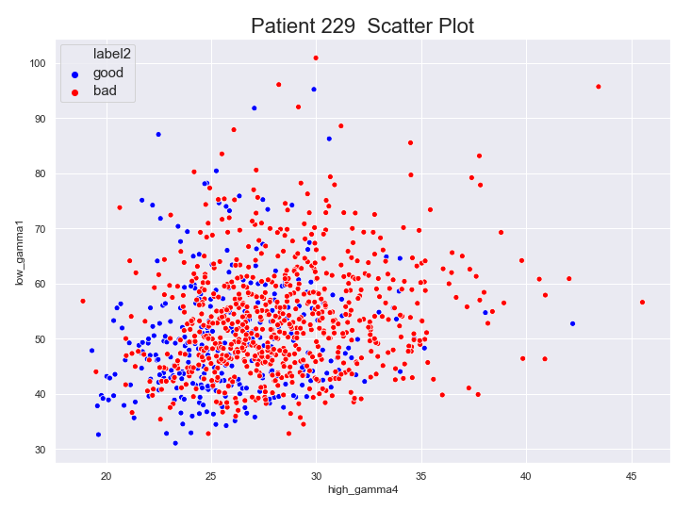
NY229: Decreased high gamma predicts good outcome
Notes:
Xlable:channel 1, channel 2, …
Put gradient boosting in this same slide

Slide 20
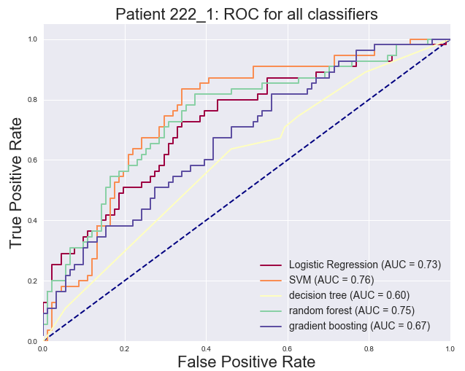
Results: NY222 model with fair performance
Best classifier for 222_1 is SVM with AUC = 0.76, accuracy = 71.92%

Slide 21
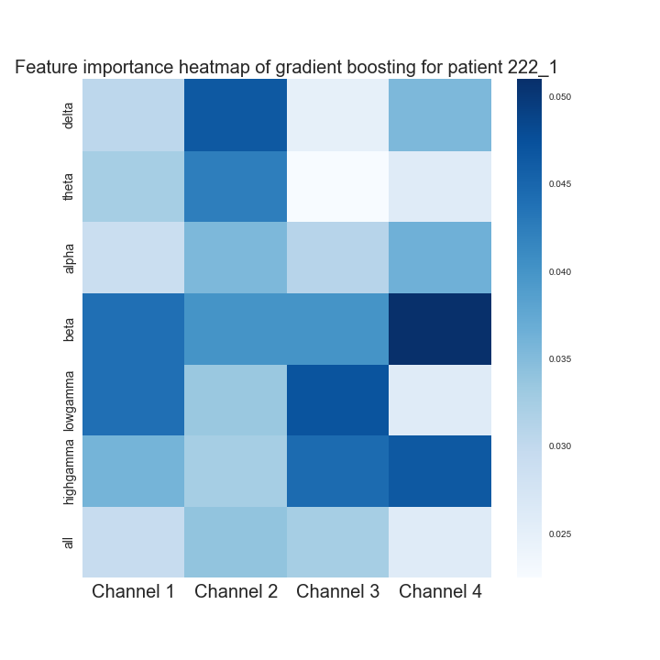
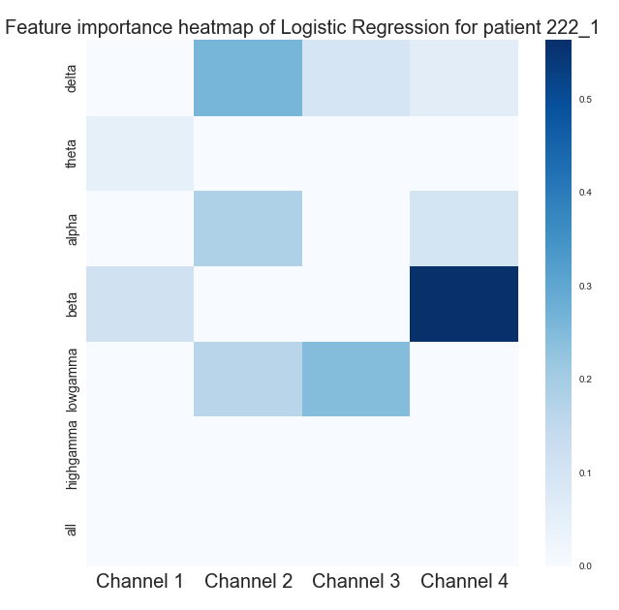
NY222 Important Features
Logistic Regression
Gradient boosting
Important features:
beta Channel 4
low gamma Channel 3
delta Channel 2
Important features:
beta Channel 4
low gamma Channel 3
delta Channel 2
Notes:
Xlable:channel 1, channel 2, …
Put gradient boosting in this same slide

Slide 22
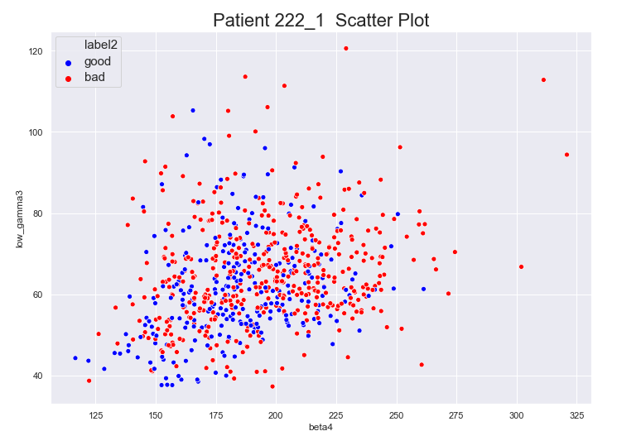
NY229: Decreased beta predicts good outcome
Notes:
Xlable:channel 1, channel 2, …
Put gradient boosting in this same slide

Slide 23
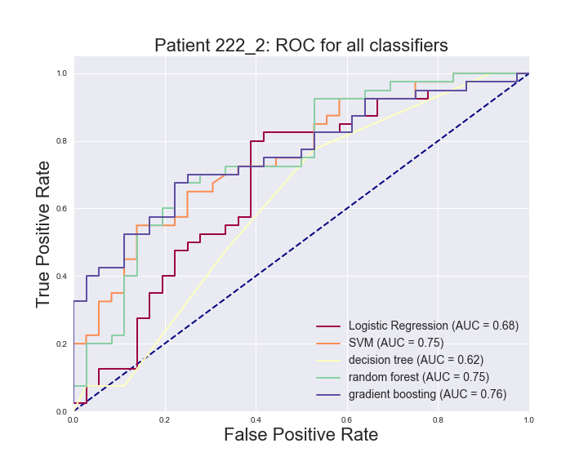
Results
Best classifier for 222_2 is gradient boosting with AUC = 0.76 , accuracy = 72.37%

Slide 24
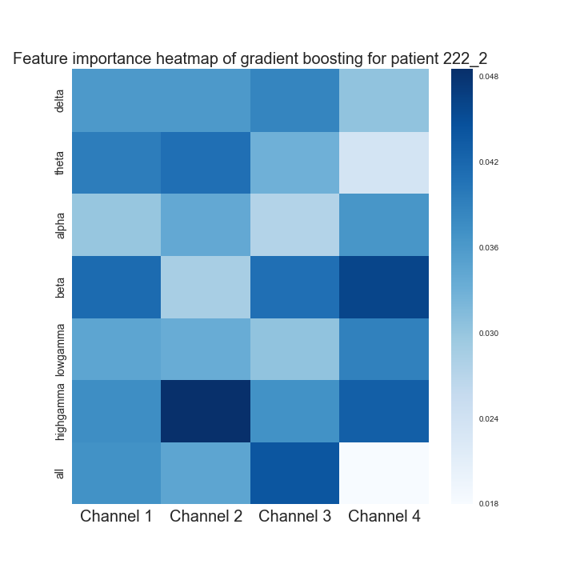
Results
Gradient boosting
Important features:
high gamma Channel 2
beta Channel 4
all Channel 3
Notes:
Xlable:channel 1, channel 2, …
Put gradient boosting in this same slide

Slide 25
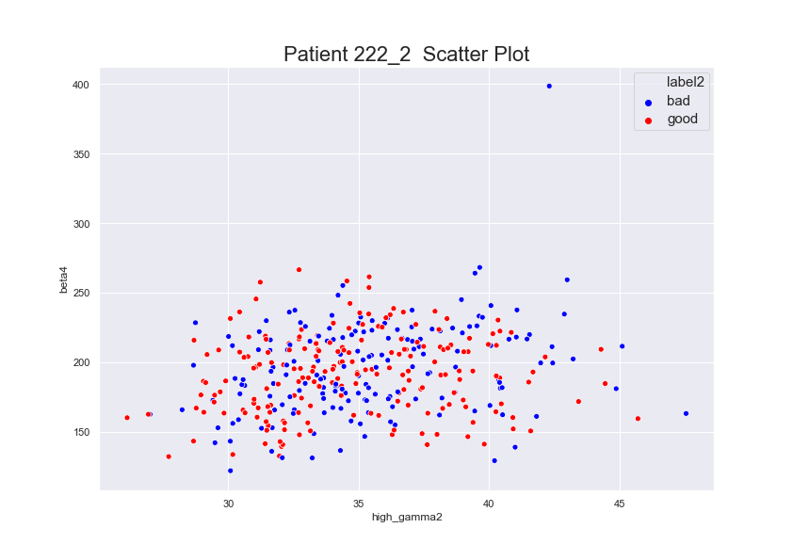
Results
Notes:
Xlable:channel 1, channel 2, …
Put gradient boosting in this same slide

Slide 26
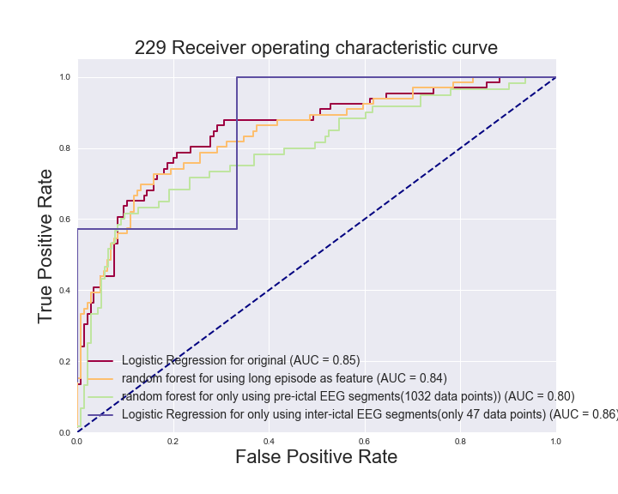
Results – discussion 1
Discover the role of pre-ictal EEG segments in predicting clinical conditions
Notes:
To overcome the problem of data insuffiency for this patient, we also included long-episode EEG segments
pre-ictal EEG is the first several seconds before the first stimulation of Long Episode EEG segments

Slide 27
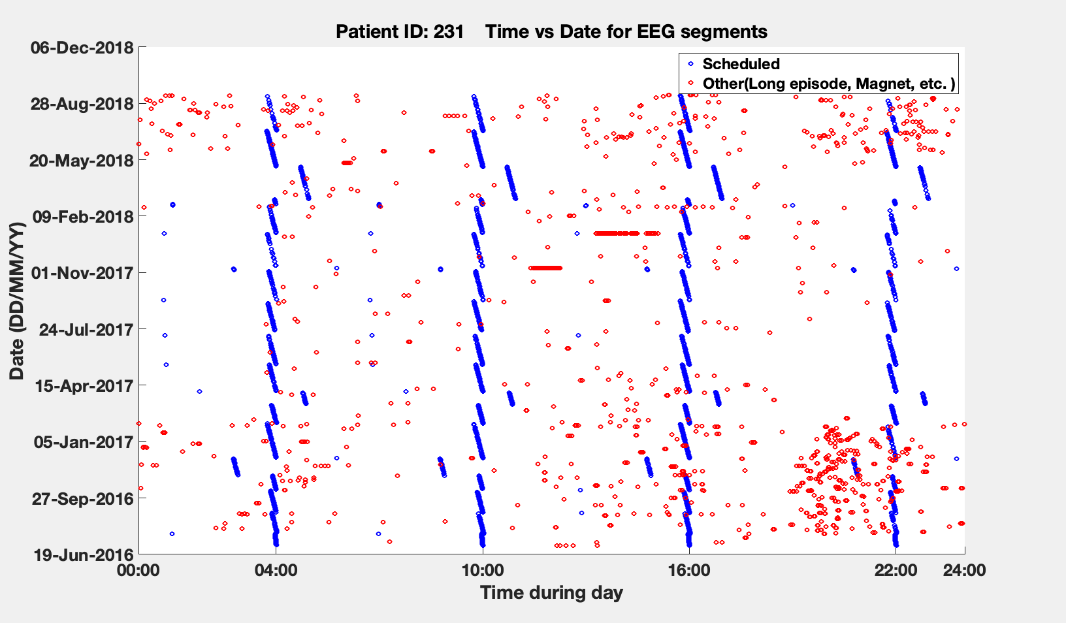
Can sleep ECoG predict clinical outcome?
Notes:
Time vs date

Slide 28
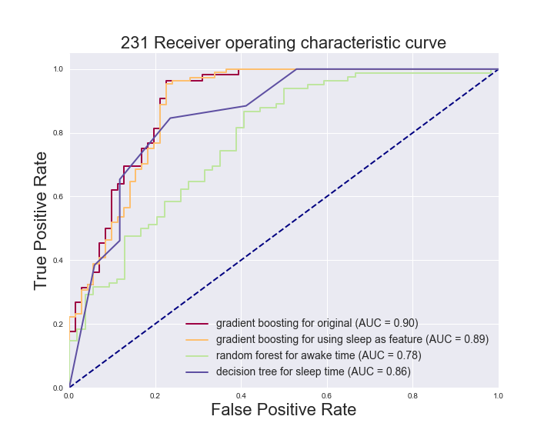
NY231: Using sleep as a central feature maintains comparable
Model performance

Slide 29
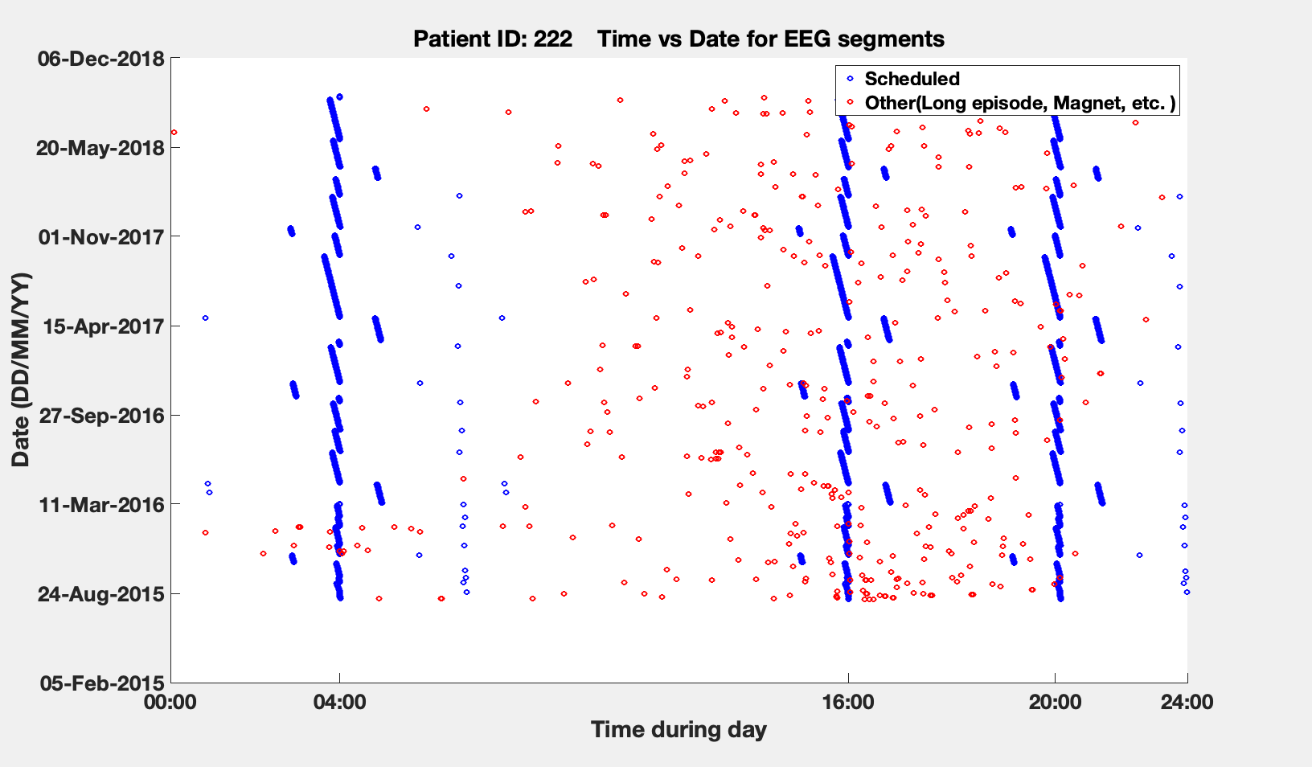
Results – discussion 2
How does sleep ECoG predict clinical outcome?
Notes:
Time vs date

Slide 30
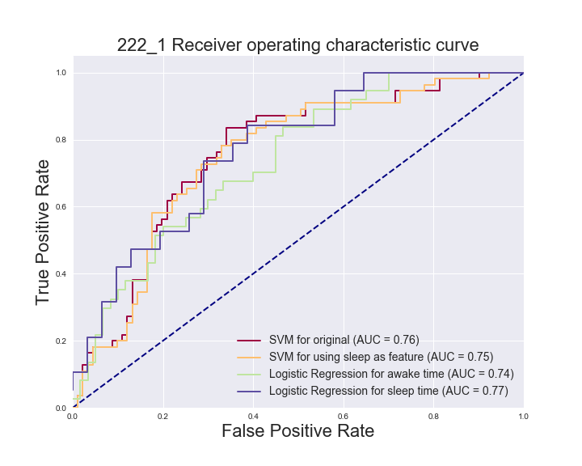
NY222: Using sleep as a central feature maintains comparable
Model performance

Slide 31
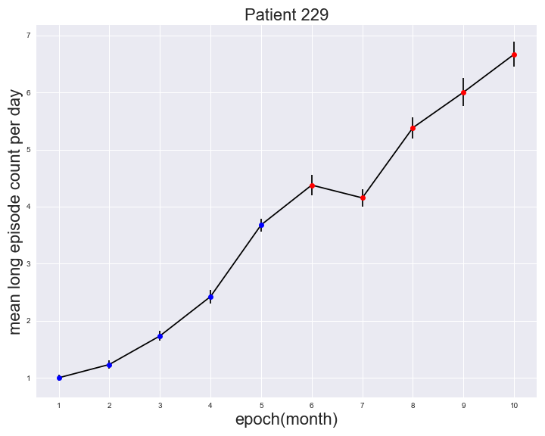
Results – discussion 3
Average long-episode number per day, over one-month epochs

Slide 32
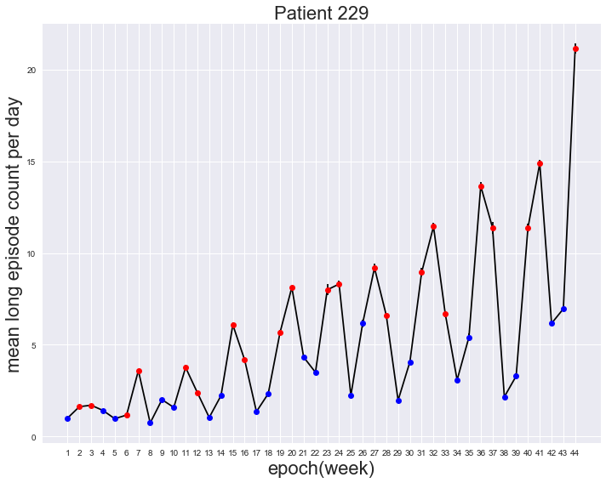
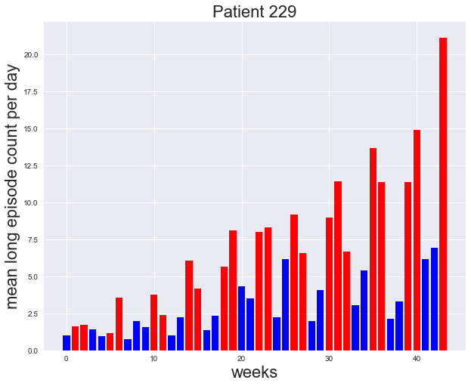
Results – discussion 3
Average long-episode number per day, over one-week epochs

Slide 33
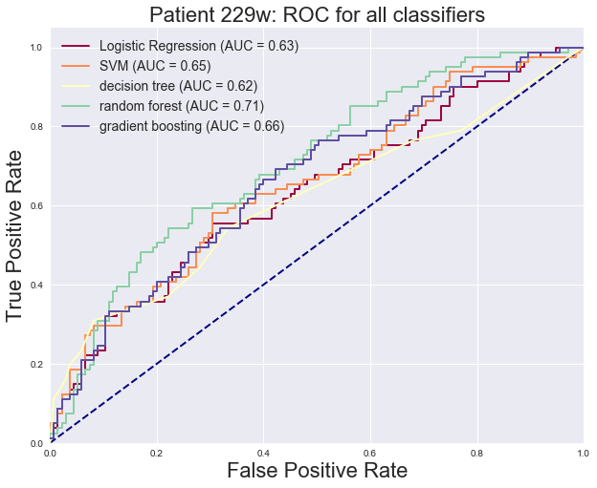
229 monthly ROC plot
Results – discussion 3
229 weekly ROC plot

Slide 34
Summary
Machine learning algorithms can be applied to retrospectively analyze background RNS ECoG segments of individual patients, to yield models which classify seizure outcomes with fair to excellent performance
Gradient boosting and logistic regression algorithms appear to outperform other approaches.
Feature importance analysis implicates greater contributions from higher frequency bands (gamma, beta)
Sleep ECoG achieves better classification performance when compared to awake ECoG.
Future directions are to test this approach in more patients, identify other candidate EEG features, and refine approach for real-world clinical application

Slide 35
Appendix

Slide 36
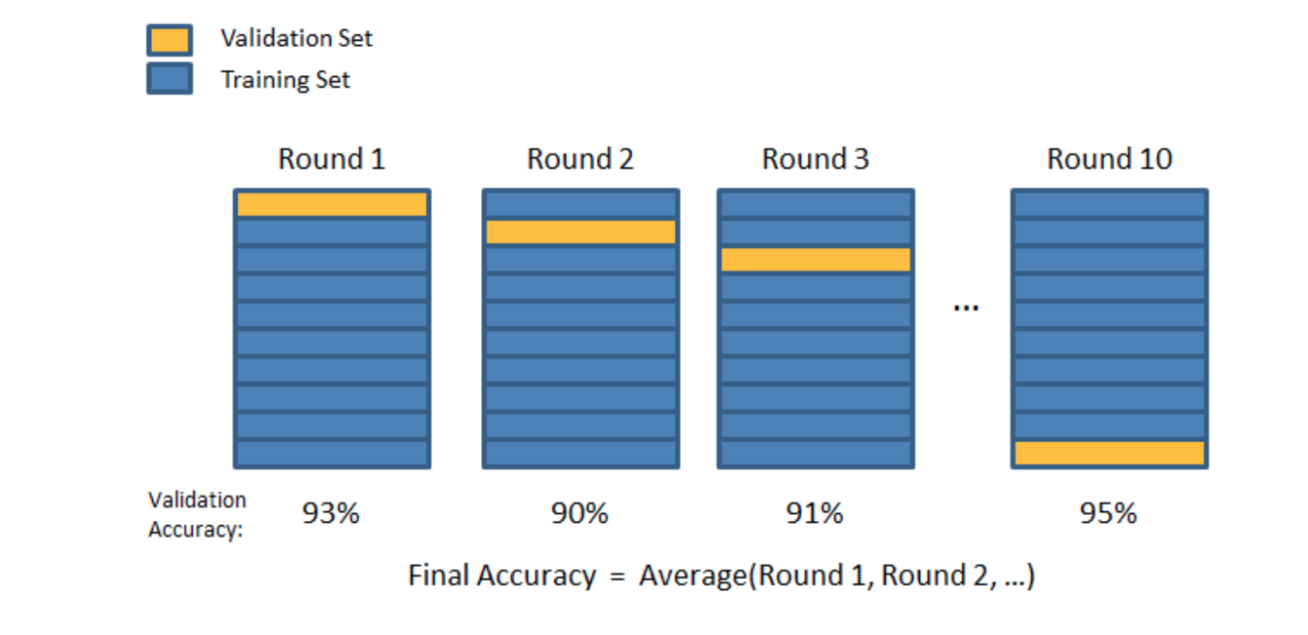
Experiments
Training, Testing and Cross-validation

